Slide 1
Final Presentation
Schools-Hub
By Najeeb, Daud, Umair

Slide 2
Problem Statement
Current school selection process for parents and guardians is complicated and time consuming.
It also lack of centralized and reliable information about educational institutions.

Slide 3
Proposed Solution
The innovative platform will serve as a centralized schooling hub, hosting profiles of various schools, enabling end users to select school and make well-informed decisions for their children’s future with respect to their needs.
Users, primarily parents and guardians, will have the ability to search, filter, and compare schools based on a variety of parameters such as location, available facilities, tuition fees, etc.

Slide 4
Project Scope
User management.
Admin Dashboard
School Profile Management.
School Searching.
AI Bot
Advanced School Filtering
Filter School Nearby
Reviews and Ratings
Read Blogs

Slide 5
Existing Systems
These are the few Platforms that are serving the same purpose and are available on the web:
SchoolDigger.com
Niche.com
GreatSchools.org

Slide 6
Target Audience
The target audience for the proposed web platform encompasses:
Students
Parents / Guardians
Schools

Slide 7
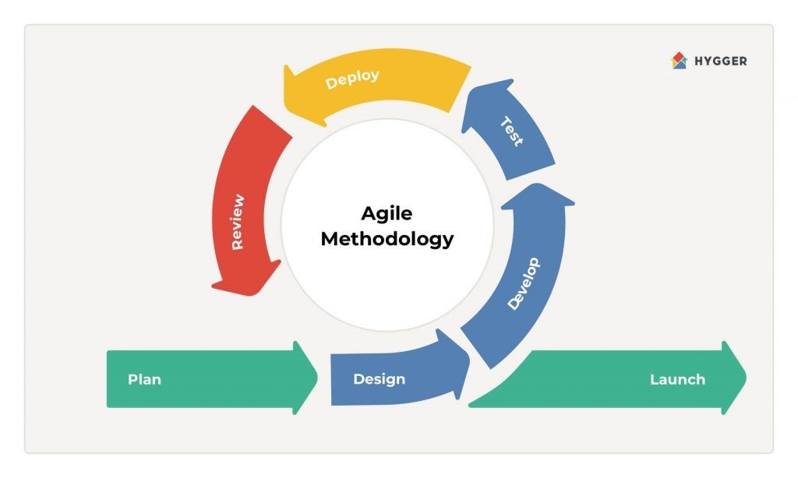
Agile Methodology
Planning and Requirements Analysis.
Interface Design.
Development and Coding.
Testing.
Reviewing.

Slide 8
Feature 1: Comprehensive School Profiles
Provide detailed information about each school, including:
School Overview:
School Admission:
School Fee:
School Gallery:
School Facilities:
About the School:
School Contact:

Slide 9
Feature 2: Advanced Searching Filters
Empower users with the ability to fine-tune their school search using advanced filters:
City
School Level
School Type
School Size
School Medium
School Curriculum
School System

Slide 10
Feature 3: Advanced Location Filter
Enable users to utilize their current location to find nearby schools:
Utilize GPS technology to provide users with a list of schools in close proximity to their current location.

Slide 11
Feature 4: Review and Rating System
Foster transparency and community engagement through a comprehensive review and rating system:
Users can rate schools across five dimensions:
School Environment
School Academics
School Faculty
School Performance
Recommendation to Others
Additionally, users can provide detailed text reviews, offering valuable feedback to both schools and prospective parents/guardians.

Slide 12
Feature 5: AI Chat Bot
Our AI chat bot serves as a virtual assistant, providing prompt responses and valuable insights on various topics related to education, school selection, and child growth.
Users can interact with the chat bot in real-time, receiving personalized recommendations and guidance tailored to their specific needs and queries.

Slide 13
Feature 6: Educational Blogging Platform
Our platform hosts a rich repository of blogs dedicated to various aspects of child education and school selection.
Users can access a diverse range of topics, curated to address common concerns and provide valuable insights into navigating the educational landscape.

Slide 14
"Continuously evolving, always improving. Our commitment doesn't end here; it's just the beginning. Together, we'll elevate education to new heights, one innovative step at a time."

